Slide 1
[220] Tabular Data
Meena Syamkumar
Mike Doescher
Cheaters caught: 0

Slide 2
Learning Objectives Today
CSV format
purpose
syntax
comparison to spreadsheet
Reading CSV files
without header
with header
type casting
Chapter 14 of Sweigart, to (and including) “Reading Data from Reader Objects in a for Loop”
https://automatetheboringstuff.com/chapter14/

Slide 3
Today's Outline
Spreadsheets
CSVs
Reading a CSV to a list of lists
Coding examples

Slide 4
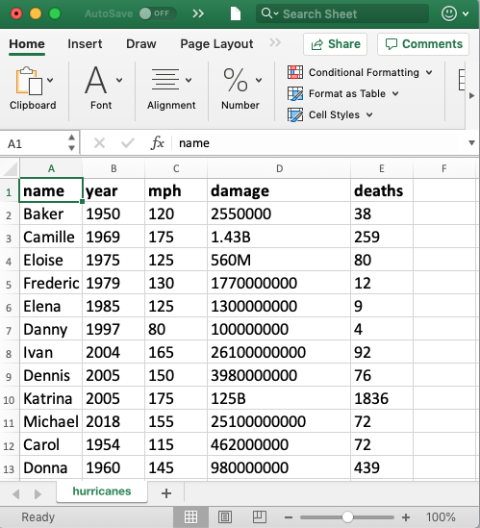
Spreadsheets (e.g., Excel)
Spreadsheets are tables of cells, organized by rows and columns

Slide 5
Spreadsheets (e.g., Excel)
Spreadsheets are tables of cells, organized by rows and columns
cells

Slide 6
Spreadsheets (e.g., Excel)
Spreadsheets are tables of cells, organized by rows and columns
columns

Slide 7
Spreadsheets (e.g., Excel)
Spreadsheets are tables of cells, organized by rows and columns
rows

Slide 8
Spreadsheets (e.g., Excel)
Spreadsheets are tables of cells, organized by rows and columns
header

Slide 9
Spreadsheets (e.g., Excel)
Spreadsheets often allow different data types
text
numbers

Slide 10
Spreadsheets (e.g., Excel)
Spreadsheets often allow different fonts
bold
regular

Slide 11
Spreadsheets (e.g., Excel)
Spreadsheets often support multiple sheets
more tables of data

Slide 12
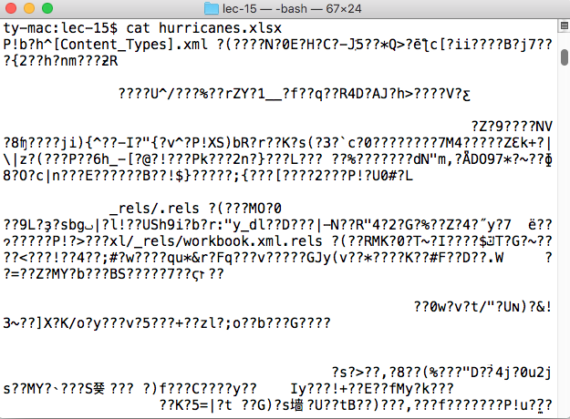
Excel Files
Extension: .xlsx
Format: binary
just 0's and 1's, not human-readable characters.
Need special software…
Writing code to read data from
Excel files is tricky, unless you
use special modules

Slide 13
Today's Outline
Spreadsheets
CSVs
Reading a CSV to a list of lists
Coding examples

Slide 14
CSVs
CSV is a simple data format that stands for Comma-Separated Values
CSVs are like simple spreadsheets
organize cells of data into rows and columns
only one sheet per file
only holds strings
no way to specify font, borders, cell size, etc
you'll do lots of type casting/conversion!

Slide 15
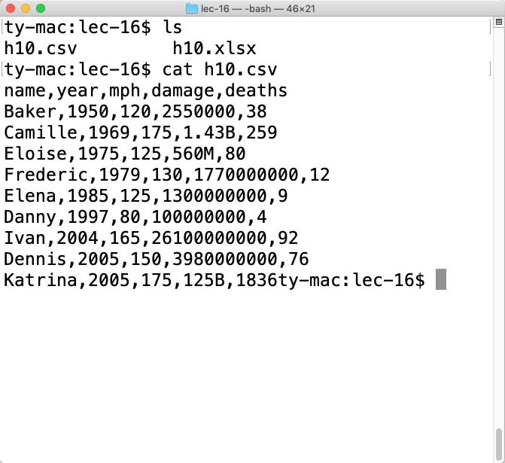
CSV Files
Extension: .csv
Format: plain text
just open in any editor (notepad, textedit, idle, etc) and you’ll be able to read it
Writing code that understands
CSV files is easy

Slide 16
Basic Syntax
Table
Name | Date | Time | Status | Latitude | Longitude | WindSpeed | Ocean
HEIDI | 19671019 | 1200 | TD | 20.5N | 54.0W | 25 | Atlantic
OLAF | 19850822 | 0 | TD | 12.9N | 102.2W | 25 | Pacific
TINA | 19920917 | 1200 | TD | 10.4N | 98.5W | 25 | Pacific
EMMY | 19760820 | 1200 | TD | 14.0N | 48.0W | 20 | Atlantic
Corresponding CSV
Name,Date,Time,Status,Latitude,Longitude,WindSpeed,Ocean
HEIDI,19671019,1200, TD,20.5N,54.0W,25,Atlantic
OLAF,19850822,0, TD,12.9N,102.2W,25,Pacific
TINA,19920917,1200, TD,10.4N,98.5W,25,Pacific
EMMY,19760820,1200, TD,14.0N,48.0W,20,Atlantic
Each row is a line of the file

Slide 17
Basic Syntax
Table
Name | Date | Time | Status | Latitude | Longitude | WindSpeed | Ocean
HEIDI | 19671019 | 1200 | TD | 20.5N | 54.0W | 25 | Atlantic
OLAF | 19850822 | 0 | TD | 12.9N | 102.2W | 25 | Pacific
TINA | 19920917 | 1200 | TD | 10.4N | 98.5W | 25 | Pacific
EMMY | 19760820 | 1200 | TD | 14.0N | 48.0W | 20 | Atlantic
Corresponding CSV
Name,Date,Time,Status,Latitude,Longitude,WindSpeed,Ocean
HEIDI,19671019,1200, TD,20.5N,54.0W,25,Atlantic
OLAF,19850822,0, TD,12.9N,102.2W,25,Pacific
TINA,19920917,1200, TD,10.4N,98.5W,25,Pacific
EMMY,19760820,1200, TD,14.0N,48.0W,20,Atlantic
Each row is a line of the file

Slide 18
Basic Syntax
Table
Name | Date | Time | Status | Latitude | Longitude | WindSpeed | Ocean
HEIDI | 19671019 | 1200 | TD | 20.5N | 54.0W | 25 | Atlantic
OLAF | 19850822 | 0 | TD | 12.9N | 102.2W | 25 | Pacific
TINA | 19920917 | 1200 | TD | 10.4N | 98.5W | 25 | Pacific
EMMY | 19760820 | 1200 | TD | 14.0N | 48.0W | 20 | Atlantic
Corresponding CSV
Name,Date,Time,Status,Latitude,Longitude,WindSpeed,Ocean
HEIDI,19671019,1200, TD,20.5N,54.0W,25,Atlantic
OLAF,19850822,0, TD,12.9N,102.2W,25,Pacific
TINA,19920917,1200, TD,10.4N,98.5W,25,Pacific
EMMY,19760820,1200, TD,14.0N,48.0W,20,Atlantic
Cells…

Slide 19
Basic Syntax
Table
Name | Date | Time | Status | Latitude | Longitude | WindSpeed | Ocean
HEIDI | 19671019 | 1200 | TD | 20.5N | 54.0W | 25 | Atlantic
OLAF | 19850822 | 0 | TD | 12.9N | 102.2W | 25 | Pacific
TINA | 19920917 | 1200 | TD | 10.4N | 98.5W | 25 | Pacific
EMMY | 19760820 | 1200 | TD | 14.0N | 48.0W | 20 | Atlantic
Corresponding CSV
Name,Date,Time,Status,Latitude,Longitude,WindSpeed,Ocean
HEIDI,19671019,1200, TD,20.5N,54.0W,25,Atlantic
OLAF,19850822,0, TD,12.9N,102.2W,25,Pacific
TINA,19920917,1200, TD,10.4N,98.5W,25,Pacific
EMMY,19760820,1200, TD,14.0N,48.0W,20,Atlantic
… are separated by commas

Slide 20
Basic Syntax
Table
Name | Date | Time | Status | Latitude | Longitude | WindSpeed | Ocean
HEIDI | 19671019 | 1200 | TD | 20.5N | 54.0W | 25 | Atlantic
OLAF | 19850822 | 0 | TD | 12.9N | 102.2W | 25 | Pacific
TINA | 19920917 | 1200 | TD | 10.4N | 98.5W | 25 | Pacific
EMMY | 19760820 | 1200 | TD | 14.0N | 48.0W | 20 | Atlantic
Corresponding CSV
We call characters that act a separators “delimiters”
Newlines delimit rows
The comma is a delimiter between cells in a row
Name,Date,Time,Status,Latitude,Longitude,WindSpeed,Ocean
HEIDI,19671019,1200, TD,20.5N,54.0W,25,Atlantic
OLAF,19850822,0, TD,12.9N,102.2W,25,Pacific
TINA,19920917,1200, TD,10.4N,98.5W,25,Pacific
EMMY,19760820,1200, TD,14.0N,48.0W,20,Atlantic
… are separated by commas

Slide 21
Advanced Syntax
We won’t go into details here, but there are some complexities
Motivation for more complicated syntax
what if a cell contains a newline?
what if we want a comma inside a cell?
what if a cell contains a quote?
what if we want to use different delimiters between rows/cells?
usually better to use a general CSV module than roll your own

Slide 22
Today's Outline
Spreadsheets
CSVs
Reading a CSV to a list of lists
Coding examples

Slide 23
Data Management
1. spreadsheet in Excel
Save As
.CSV
2. CSV file saved somewhere
name,year,mph,damage,deaths
Baker,1950,120,2550000,38
Camille,1969,175,1.43B,259
Eloise,1975,125,560M,80
Frederic,1979,130,1770000000,12

Slide 24
Data Management
3. Python Program
1. spreadsheet in Excel
[
[“name”, “year”, …], [“Baker”, “1950”, …],
…
]
list of lists
Parsing Code
we'll come back to this
Save As
.CSV
2. CSV file saved somewhere
name,year,mph,damage,deaths
Baker,1950,120,2550000,38
Camille,1969,175,1.43B,259
Eloise,1975,125,560M,80
Frederic,1979,130,1770000000,12

Slide 25
Data Management
3. Python Program
Analysis Code
rows[1][0]
????
1. spreadsheet in Excel
[
[“name”, “year”, …], [“Baker”, “1950”, …],
…
]
list of lists
Parsing Code
Save As
.CSV
2. CSV file saved somewhere
name,year,mph,damage,deaths
Baker,1950,120,2550000,38
Camille,1969,175,1.43B,259
Eloise,1975,125,560M,80
Frederic,1979,130,1770000000,12

Slide 26
Data Management
3. Python Program
Analysis Code
rows[1][0]
"Baker"
1. spreadsheet in Excel
[
[“name”, “year”, …], [“Baker”, “1950”, …],
…
]
list of lists
Parsing Code
Save As
.CSV
2. CSV file saved somewhere
name,year,mph,damage,deaths
Baker,1950,120,2550000,38
Camille,1969,175,1.43B,259
Eloise,1975,125,560M,80
Frederic,1979,130,1770000000,12

Slide 27
Data Management
3. Python Program
Analysis Code
rows[3][1]
????
1. spreadsheet in Excel
[
[“name”, “year”, …], [“Baker”, “1950”, …],
…
]
list of lists
Parsing Code
Save As
.CSV
2. CSV file saved somewhere
name,year,mph,damage,deaths
Baker,1950,120,2550000,38
Camille,1969,175,1.43B,259
Eloise,1975,125,560M,80
Frederic,1979,130,1770000000,12

Slide 28
Data Management
3. Python Program
Analysis Code
rows[3][1]
“1975”
1. spreadsheet in Excel
[
[“name”, “year”, …], [“Baker”, “1950”, …],
…
]
list of lists
Parsing Code
Save As
.CSV
2. CSV file saved somewhere
name,year,mph,damage,deaths
Baker,1950,120,2550000,38
Camille,1969,175,1.43B,259
Eloise,1975,125,560M,80
Frederic,1979,130,1770000000,12

Slide 29
Data Management
3. Python Program
Analysis Code
rows[1][-1]
????
1. spreadsheet in Excel
[
[“name”, “year”, …], [“Baker”, “1950”, …],
…
]
list of lists
Parsing Code
Save As
.CSV
2. CSV file saved somewhere
name,year,mph,damage,deaths
Baker,1950,120,2550000,38
Camille,1969,175,1.43B,259
Eloise,1975,125,560M,80
Frederic,1979,130,1770000000,12

Slide 30
Data Management
3. Python Program
Analysis Code
rows[1][-1]
"38"
1. spreadsheet in Excel
[
[“name”, “year”, …], [“Baker”, “1950”, …],
…
]
list of lists
Parsing Code
Save As
.CSV
2. CSV file saved somewhere
name,year,mph,damage,deaths
Baker,1950,120,2550000,38
Camille,1969,175,1.43B,259
Eloise,1975,125,560M,80
Frederic,1979,130,1770000000,12

Slide 31
Data Management
3. Python Program
Analysis Code
rows[0][-2]
????
1. spreadsheet in Excel
[
[“name”, “year”, …], [“Baker”, “1950”, …],
…
]
list of lists
Parsing Code
Save As
.CSV
2. CSV file saved somewhere
name,year,mph,damage,deaths
Baker,1950,120,2550000,38
Camille,1969,175,1.43B,259
Eloise,1975,125,560M,80
Frederic,1979,130,1770000000,12

Slide 32
Data Management
3. Python Program
Analysis Code
rows[0][-2]
"damage"
1. spreadsheet in Excel
[
[“name”, “year”, …], [“Baker”, “1950”, …],
…
]
list of lists
Parsing Code
Save As
.CSV
2. CSV file saved somewhere
name,year,mph,damage,deaths
Baker,1950,120,2550000,38
Camille,1969,175,1.43B,259
Eloise,1975,125,560M,80
Frederic,1979,130,1770000000,12

Slide 33
Data Management
3. Python Program
Analysis Code
rows[0][-2]
"damage"
1. spreadsheet in Excel
[
[“name”, “year”, …], [“Baker”, “1950”, …],
…
]
list of lists
Parsing Code
Parsing Code
Save As
.CSV
2. CSV file saved somewhere
What does this look like?
name,year,mph,damage,deaths
Baker,1950,120,2550000,38
Camille,1969,175,1.43B,259
Eloise,1975,125,560M,80
Frederic,1979,130,1770000000,12

Slide 34
Example Copied From Sweigart Ch 14
import csv
exampleFile = open('example.csv')
exampleReader = csv.reader(exampleFile)
exampleData = list(exampleReader)
Code
4/5/2015 13:34,Apples,73
4/5/2015 3:41,Cherries,85
4/6/2015 12:46,Pears,14
4/8/2015 8:59,Oranges,52
4/10/2015 2:07,Apples,152
4/10/2015 18:10,Bananas,23
4/10/2015 2:40,Strawberries,98
example.csv

Slide 35
Example Copied From Sweigart Ch 14
import csv
exampleFile = open('example.csv')
exampleReader = csv.reader(exampleFile)
exampleData = list(exampleReader)
exampleData
Code
list of
lists
[['4/5/2015 13:34', 'Apples', '73'], ['4/5/2015 3:41', 'Cherries', '85'],
['4/6/2015 12:46', 'Pears', '14'], ['4/8/2015 8:59', 'Oranges', '52'],
['4/10/2015 2:07', 'Apples', '152'], ['4/10/2015 18:10', 'Bananas', '23'],
['4/10/2015 2:40', 'Strawberries', '98']]

Slide 36
Example Copied From Sweigart Ch 14
import csv
exampleFile = open('example.csv')
exampleReader = csv.reader(exampleFile)
exampleData = list(exampleReader)
exampleData
let's generalize this to a function
(don't need to know exactly how the code
works, though we will eventually)

Slide 37
Example Copied From Sweigart Ch 14
import csv
exampleFile = open('example.csv')
exampleReader = csv.reader(exampleFile)
exampleData = list(exampleReader)
exampleData
input
output
let's generalize this to a function
(don't need to know exactly how the code
works, though we will eventually)

Slide 38
Example Copied From Sweigart Ch 14
def process_csv():
import csv
exampleFile = open('example.csv')
exampleReader = csv.reader(exampleFile)
exampleData = list(exampleReader)
exampleData
1. move code to a function

Slide 39
Example Copied From Sweigart Ch 14
import csv
def process_csv():
import csv
exampleFile = open('example.csv')
exampleReader = csv.reader(exampleFile)
exampleData = list(exampleReader)
exampleData
2. move out imports

Slide 40
Example Copied From Sweigart Ch 14
import csv
def process_csv():
import csv
exampleFile = open('example.csv')
exampleReader = csv.reader(exampleFile)
exampleData = list(exampleReader)
return exampleData
3. return data to get it out of the function

Slide 41
Example Copied From Sweigart Ch 14
import csv
def process_csv():
import csv
exampleFile = open('example.csv')
exampleReader = csv.reader(exampleFile)
exampleData = list(exampleReader)
return exampleData
4. generalize input

Slide 42
Example Copied From Sweigart Ch 14
import csv
def process_csv(filename):
import csv
exampleFile = open(filename)
exampleReader = csv.reader(exampleFile)
exampleData = list(exampleReader)
return exampleData
4. generalize input

Slide 43
Example Copied From Sweigart Ch 14
import csv
# copied from https://automatetheboringstuff.com/chapter14/
def process_csv(filename):
import csv
exampleFile = open(filename)
exampleReader = csv.reader(exampleFile)
exampleData = list(exampleReader)
return exampleData
Reminder!
cite code
copied online
5. cite the code

Slide 44
Example Copied From Sweigart Ch 14
import csv
# copied from https://automatetheboringstuff.com/chapter14/
def process_csv(filename):
exampleFile = open(filename, encoding="utf-8")
exampleReader = csv.reader(exampleFile)
exampleData = list(exampleReader)
exampleFile.close()
return exampleData
keep this handy for copy/paste

Slide 45
Today's Outline
Spreadsheets
CSVs
Reading a CSV to a list of lists
Coding examples

Slide 46

Demo 1: Restaurant Location Lookup
Goal: given a restaurant name, give x,y coordinates for it
Input:
Restaurant name (and a CSV file)
Output:
X, Y coordinates
Example: prompt> python rlookup.py subway x=1, y=0 prompt> python rlookup.py mcdonalds x=4, y=-3
y
?
x

Slide 47
Demo 2: Nearest Restaurant Search
Goal: given a location, find the nearest restaurant
Input:
X, Y coordinates (and a CSV file)
Output:
nearest restaurant
Example: prompt> python nearest.py 4,-4 McDonalds prompt> python nearest.py -2,0 The Sett
shortest
x

Slide 48
Demo 3: Hurricane Column Dump
Goal: column name, print that data for all hurricanes
Input:
column name (and a CSV file)
Output:
data in given column, associated with name
Example: prompt> python dump.py hurricanes.csv year Baker: 1950 Camille: 1969 Eloise: 1975 …

Slide 49
Demo 4: Hurricanes per Year
Goal: column name, print that data for all hurricanes
Input:
none typed (only a CSV file)
Output:
the number of hurricanes in each year
Example: prompt> python yearly.py 1967: 23 1968: 29 2969: 15 …

Slide 50

Demo 5: Hurricane Names and Stereotypes
this analysis is tricky and much debated
what would it take to try to replicate this study?
simple version: classify names and count deaths

